Slide 1
Basic Statistics using R
- Linga Reddy Baddam

Slide 2
Agenda
  Descriptive Statistics using R
  T-tests (One-Sample, Independent and Paired tests) using R
  Q & A

Slide 3
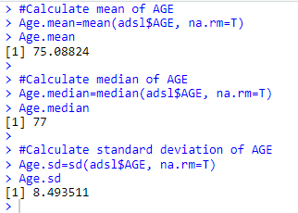
Descriptive Statistics
mean, sd, var, min, max, median, range, and quantile are the functions to obtain descriptive statistics.
#Read ADSL
data("admiral_adsl")
adsl <- convert_blanks_to_na(admiral_adsl)
#Calculate mean of AGE
  Age.mean=mean(adsl$AGE, na.rm=T)
#Calculate median of AGE
  Age.median=median(adsl$AGE, na.rm=T)
#Calculate Standard Deviation of AGE
  Age.sd=sd(adsl$AGE, na.rm=T)

Slide 4

Descriptive Statistics
Summary() function gives mean, median, 25th and 75th quartiles, min, max
Age.sum=summary(adsl$AGE, na.rm=T)
Age.sum

Slide 5
T- test syntax
Performs one and two sample t-tests on vectors of data
Syntax: t.test(x, ...)
Arguments:
x : a (non-empty) numeric vector of data values.
y : an optional (non-empty) numeric vector of data values.
alternative : a character string specifying the alternative hypothesis, must be one of "two.sided" (default), "greater" or "less". You can specify just the initial letter.
mu : a number indicating the true value of the mean (or difference in means if you are performing a two sample test).
paired : a logical indicating whether you want a paired t-test.
var.equal : a logical variable indicating whether to treat the two variances as being equal. If TRUE then the pooled variance is used to estimate the variance otherwise the Welch (or Satterthwaite) approximation to the degrees of freedom is used.
conf.level : confidence level of the interval.
formula : a formula of the form lhs ~ rhs where lhs is a numeric variable giving the data values and rhs a factor with two levels giving the corresponding groups.
data : an optional matrix or data frame containing the variables in the formula.

Slide 6
One Sample T- test
One sample T- test
The One-Sample T-test compares the mean of a sample to a known value. Usually, the known value is a population mean.
Hypotheses:
H0: There is no significant difference between the sample mean and the population mean.
H1: There is a significant difference between the sample mean and the population mean.
Assumptions:
The data must be continuous.
The data must follow the normal probability distribution.
The sample is a simple random sample from its population.
Test Statistic:
Where

Slide 7

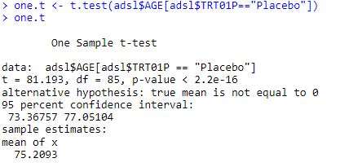
R code and output
#Read data
library(admiral)
data("admiral_adsl")
adsl <- convert_blanks_to_na(admiral_adsl)
#Shapiro-Wilk Normality test
shapiro.test(adsl$AGE[adsl$TRT01P=="Placebo"])
#Perform one sample t-test
one.t <- t.test(adsl$AGE[adsl$TRT01P=="Placebo"])
one.t

Slide 8
Independent T-test
Independent T- test (two sample)
The Independent sample T Test compares the means of two groups on a given variable.
Hypotheses:
H0: The means of the two groups are not significantly different.
H1: The means of the two groups are significantly different.
Assumptions:
The data must be continuous.
The data must follow the normal probability distribution.
The variances of the two populations are equal. (If not, the Aspin-Welch (or Satterthwaite) Unequal-Variance test is used.)
Two samples are independent. There is no relationship between the individuals in one sample as compared to the other.
Both the samples are simple random sample from their respective population.
Test Statistic:
where

Slide 9
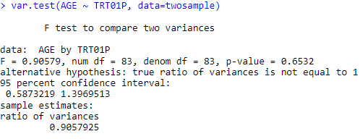
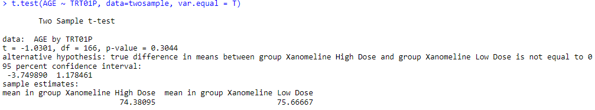
R code and output
#Read data
twosample <- adsl %>%
filter(TRT01P %in% c("Xanomeline High Dose", "Xanomeline Low Dose")) %>%
select(USUBJID, AGE, TRT01P)
# F test to compare two variances
var.test(AGE ~ TRT01P, data=twosample)
#Perform independent t-test
t.test(AGE ~ TRT01P, data=twosample, var.equal = T)

Slide 10
Paired T-test
Paired T- test (two sample)
The paired samples T Test compares the means of two variables. It computes the difference between the two variables for each case, and tests to see if the average difference is significantly different from zero.
Hypotheses:
H0: There is no significant difference between the means of the two variables.
H1: There is a significant difference between the means of the two variables.
Assumptions:
The data must be continuous.
The data, i.e., the differences for the matched pairs, follow a normal probability distribution.
The sample of pairs is a simple random sample from its population.
Test Statistic:
Where d bar is the mean of the differences and sd is the standard deviations of the differences.

Slide 11
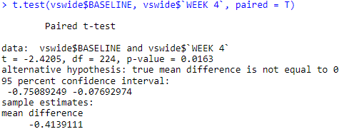
R code and output
#Read data
data("admiral_vs")
vs <- convert_blanks_to_na(admiral_vs)
vswide <- vs %>%
filter(VSTESTCD=="WEIGHT", VISIT %in% c("BASELINE", "WEEK 4")) %>%
select(USUBJID, VSTESTCD, VISIT, VSSTRESN) %>%
pivot_wider(names_from = VISIT, values_from = VSSTRESN) %>%
mutate(CHG=`WEEK 4`-BASELINE)
t.test(vswide$BASELINE, vswide$`WEEK 4`, paired = T
t.test(vswide$CHG)

Slide 12


